Slide 1
What is Talend
Eclipse-based visual programming editor
Generates executables Java code
Jobs can run standalone or embedded( no special server)

Slide 2
Introduction to Talend Activity Monitoring Console
Talend Activity Monitoring Console is an add-on tool integrated in the studio and in Talend Administration Center for monitoring Talend Jobs and projects.

Slide 3
AMC
The Talend Activity Monitoring Console (AMC) is an add-on to Talend Data Integration that is largely overlooked by Open Source users.
The Enterprise Edition provides a web interface and an interface via the Studio to monitor job statistics.
Unfortunately the Open Source edition does not.

Slide 4
Talend Activity Monitoring Console (AMC )
Talend Activity Monitoring Console provides detailed monitoring capabilities that can be used to consolidate the collected activity monitoring information, understand the underlying component and Job interaction, prevent faults that could be unexpectedly generated and support system management decisions.

Slide 5
Talend Activity Monitoring Console (AMC )
Activity monitoring information can be stored in delimited files or database tables.
Before collecting and reusing the activity monitoring information of your Talend Jobs, you have to:
•Create files or database tables to be used as data sources for the activity monitoring information.
•Enable activity monitoring either by configuring the Stats & Logs settings at the project level or Job level or by adding the relevant components to your Jobs in order to catch and record the activity monitoring information and deliver it to the defined output (files or database tables).
•Configure the data sources to retrieve the activity monitoring information, which can be displayed on Talend Activity Monitoring Console either from the studio or from the Monitoring module of Talend Administration Center.

Slide 6
Different Log Types
1. AMC STAT DATA : tStatCatcher
2. AMC FLOW DATA : tFlowMeterCatcher
3. AMC LOG DATA : tLogCatcher

Slide 7
Generating and Storing Logs in Files/Database
to open the dialog box directly.
To enable activity monitoring for a project in your studio, do the following:
Select File > Edit Project properties from the menu to open the [Project Settings] dialog box.
Alternatively, you can click

Slide 8
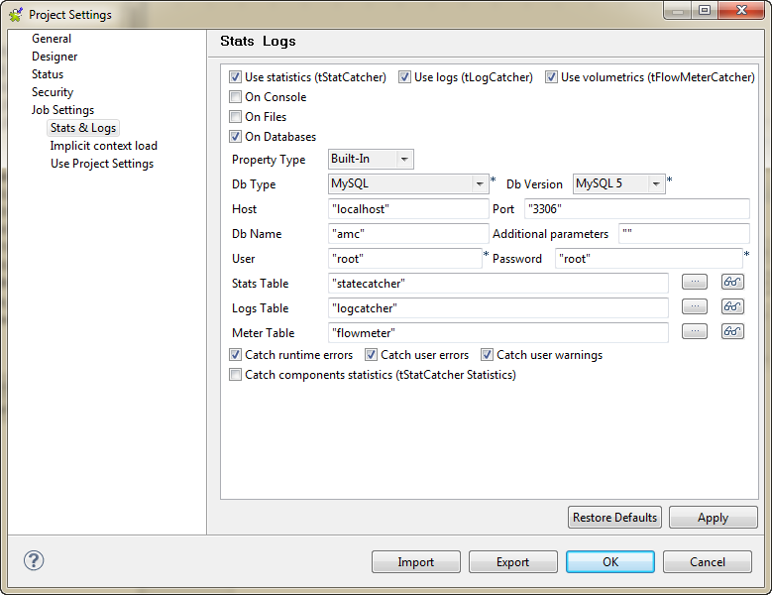

Slide 9
Creating Table
The AMC schema can be created using SQL scripts or a Talend Job. It is arguably easier to use a Talend Job and here is an example of how this can be done.
Example SQL scripts for a MySQL database are shown below. These will need to be adjusted depending on the database being used.

Slide 10
AMCSTATDATA
CREATE TABLE `statecatcher` (
`moment` datetime DEFAULT NULL,
`pid` varchar(20) DEFAULT NULL,
`father_pid` varchar(20) DEFAULT NULL,
`root_pid` varchar(20) DEFAULT NULL,
`system_pid` bigint(8) DEFAULT NULL,
`project` varchar(50) DEFAULT NULL,
`job` varchar(50) DEFAULT NULL,
`job_repository_id` varchar(255) DEFAULT NULL,
`job_version` varchar(255) DEFAULT NULL,
`context` varchar(50) DEFAULT NULL,
`origin` varchar(255) DEFAULT NULL,
`message_type` varchar(255) DEFAULT NULL,
`message` varchar(255) DEFAULT NULL,
`duration` bigint(8) DEFAULT NULL
);

Slide 11
AMCLOGDATA
CREATE TABLE `logcatcher` (
`moment` datetime DEFAULT NULL,
`pid` varchar(20) DEFAULT NULL,
`root_pid` varchar(20) DEFAULT NULL,
`father_pid` varchar(20) DEFAULT NULL,
`project` varchar(50) DEFAULT NULL,
`job` varchar(255) DEFAULT NULL,
`context` varchar(50) DEFAULT NULL,
`priority` int(3) DEFAULT NULL,
`type` varchar(255) DEFAULT NULL,
`origin` varchar(255) DEFAULT NULL,
`message` varchar(255) DEFAULT NULL,
`code` int(3) DEFAULT NULL
);

Slide 12
AMCFLOWMETERDATA
CREATE TABLE `amcflowmeterdata` (
`moment` datetime DEFAULT NULL,
`pid` varchar(20) DEFAULT NULL,
`father_pid` varchar(20) DEFAULT NULL,
`root_pid` varchar(20) DEFAULT NULL,
`system_pid` bigint(8) DEFAULT NULL,
`project` varchar(50) DEFAULT NULL,
`job` varchar(50) DEFAULT NULL,
`job_repository_id` varchar(255) DEFAULT NULL,
`job_version` varchar(255) DEFAULT NULL,
`context` varchar(50) DEFAULT NULL,
`origin` varchar(255) DEFAULT NULL,
`label` varchar(255) DEFAULT NULL,
`count` int(3) DEFAULT NULL,
`reference` int(3) DEFAULT NULL,
`thresholds` varchar(255) DEFAULT NULL
);

Slide 13
tLogCatcher, tStatCatcher and tFlowMeterCatcher are the typical components required to record respectively various logs, statistics or flow information that will be interpreted and displayed on Talend Activity Monitoring Console.
tLogCatcher can be triggered by a Java exception, tWarn or tDie.
tStatCatcher can be triggered by the tStatCatcher Statistics check box in a Job or individual components.
tFlowMeterCatcher can be triggered by tFlowMeter.

Slide 14
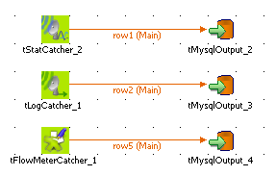
Proceed as follows:
Add the tStatCatcher, tLogCatcher and tFlowMeterCatcher components as needed to your Job.
Link them to the relevant output (either files or database tables).

Slide 15

Enabling component statistics
To trace the behaviour of each component involved in the Job in Talend Activity Monitoring Console, select the tStatCatcher
Statistics check box in the Advanced settings view of the relevant components of your Job.

Slide 16

Enabling connection monitoring
In order to ease the reading of a complex Job based on numerous connections, you can use the connection settings to avoid using the tFlowMeter component.
Proceed as follows:
Select the connection linking the two components that you want to monitor.
On the Component view, select the Advanced settings tab.
Select the Monitor this connection check box.

Slide 17
Different Views in AMC
Jobs view :
History and Detailed history views
Meter log view
Main chart view
Job Volume view
Logged Events view
Error report view
Threshold Charts view.
You can customize the views to filter the activity monitoring information and display only the information of interest in Talend Activity Monitoring Console.

Slide 18
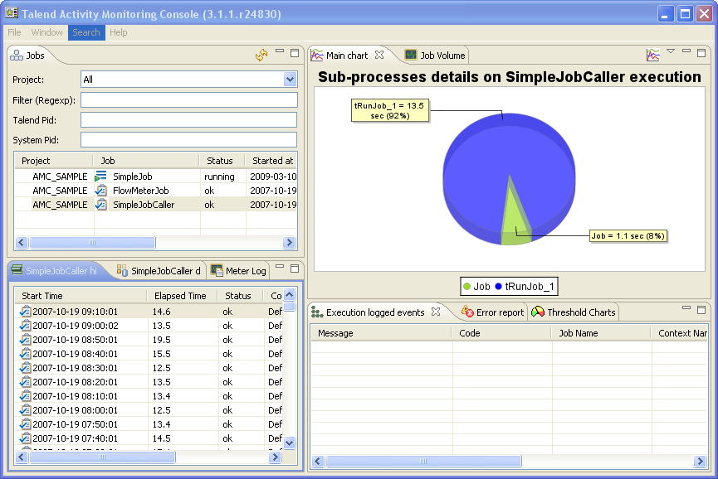

Slide 19
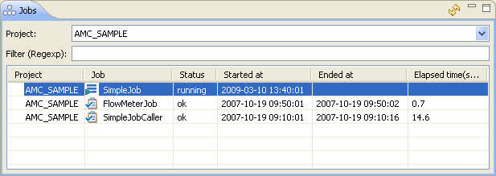
Different Views
Job View : The Jobs view provides the list of Jobs mentioned in the execution log data collected.

Slide 20
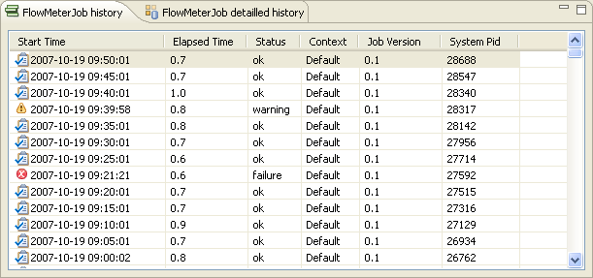
History and Detailed history views
The History view provides a summary of the Job main steps.
The Detailed History view splits up each Job into components and provides the execution details.

Slide 21
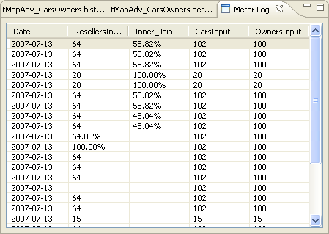
Meter Log view
The Meter Log view displays the detailed information of the various flows processed in the Job selected on the Jobs view
Logged Events view

Slide 22
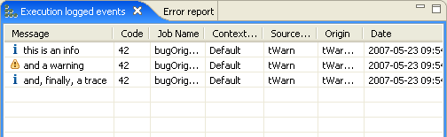
Logged Events view
The Logged Events view displays in full the messages generated through tWarn or tDie components as well as Java Exception.

Slide 23
It provides the following information: Message, Code, Job Name, Context, Source type, Origin and Date.
Message : The message displayed is defined in the Properties of the tWarn, tDie component In Talend or automatic messages of Java Exception.
Code : The code level you defined in The Properties of The tWarn or tDie component
Job Name : Name of the Job where the message is generated from.
Context : Name of the context if a specific context has been defined for the Job other than Default
Source type : Type of message component. It can be tWarn, tDie or Java Exception according to the Properties you set and the message type.

Slide 24
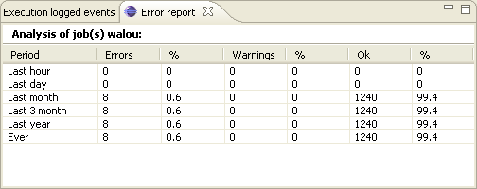
Error report view
The Error Report view provides an analysis of the proportion of errors that occurred over a number of Job executions.

Slide 25
Main Chart view
On the Main Chart view of the Talend Activity Monitoring Console window, various charts are provided to illustrate the Job instance you selected. These charts help you to quickly and intuitively understand the behaviour of Talend Jobs illustrated by the collected log data.

Slide 26
Customizing the monitoring console
Customizing Jobs view
The Jobs view provides the list of Jobs mentioned in the execution log data collected.

Slide 27
Customizing the monitoring console
You can filter Job instances following the Project they belong to, so that only the selected project's Jobs are displayed in the information list. By default all projects contained in the log sources will show up.
You can also filter on other information if you need. In the Filter field, type in the corresponding regular expression to fine-tune your selection.
More precisely, you can select one single execution. In the Talend Pid field, type in the corresponding Talend PID, execution PID (Process ID) given by your Talend application.
You can as well type in a system Pid in the System Pid field to select Job(s) according to their execution PIDs given by the operating system(s) where the Jobs run.

Slide 28
Talend and Amazon cloud connectivity

Slide 29
Introduction to S3
Amazon Simple Storage Service is storage for the Internet. It is designed to make web-scale computing easier for developers.
Amazon S3 has a simple web services interface that you can use to store and retrieve any amount of data, at any time, from anywhere on the web. It gives any developer access to the same highly scalable, reliable, fast, inexpensive data storage infrastructure that Amazon uses to run its own global network of web sites. The service aims to maximize benefits of scale and to pass those benefits on to developers.

Slide 30
Amazon Redshift
Amazon Redshift is a fully managed, petabyte-scale data warehouse service in the cloud. You can start with just a few hundred gigabytes of data and scale to a petabyte or more. This enables you to use your data to acquire new insights for your business and customers.

Slide 31
Talend S3 to Redshift
- i need to transfer this flat file to amazon aws S3. We can use tS3Put component for this. This component would need bucket/acess key/secret key details for your AWS account.
Once file has been uploaded to S3, we can use tRedshiftRow to execute copy from command and load data to aws redshift table.

Slide 32
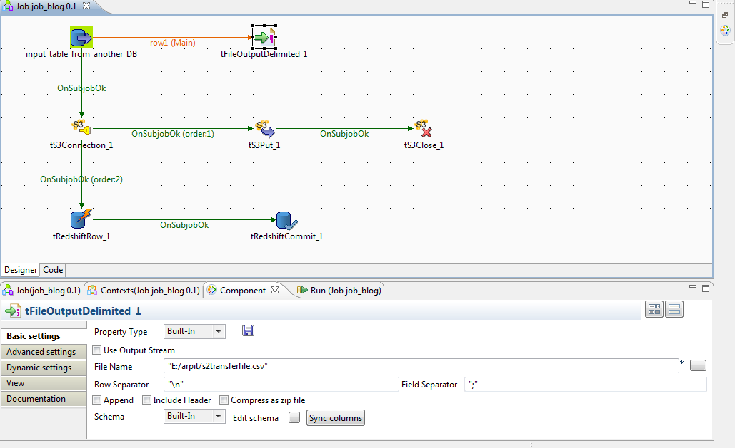

Slide 33
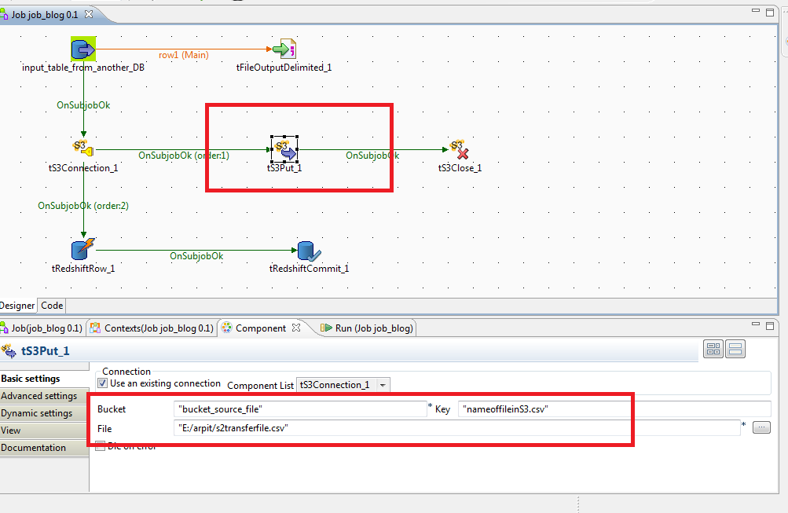

Slide 34
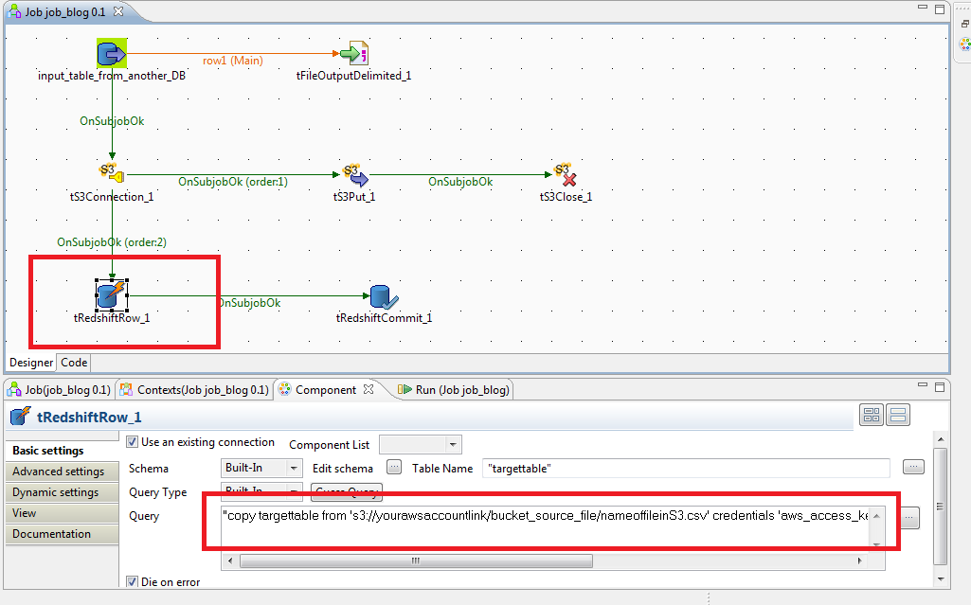

Slide 35
Questions

Slide 36
Thank You

